Slide 1

Open House ITB 2025
Fakultas Ilmu dan Teknologi Kebumian
SABUGA ITB, 13 - 14 DESEMBER 2025
https://www.itb.ac.id/

Slide 2

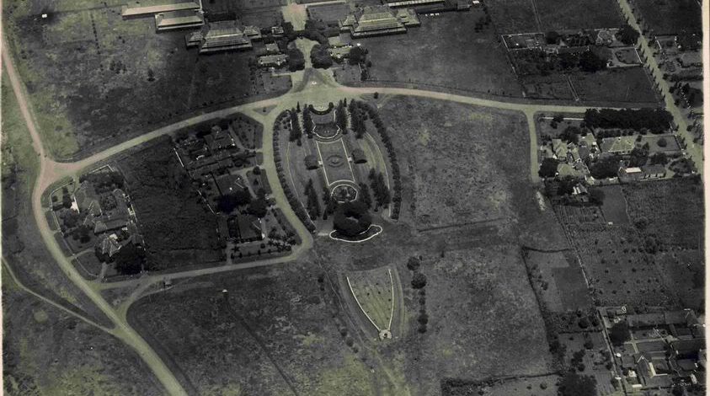
Institut Teknologi Bandung (ITB)
REFLEKSI (OPEN HOUSE 2023 dan 2024
KONSEP OPEN HOUSE 2025
KONSEP VISUAL
LAY OUT
PROPOSAL/TOR dan RUNDOWN ACARA
RENCANA ANGGARAN DAN BIAYA
3 JULI 1920:
De Techniche Hoogeschool Te Bandung
1944-1945:
Bandung Kogyo Daigaku
1945-1946:
Technical High
School (STT)

Slide 3

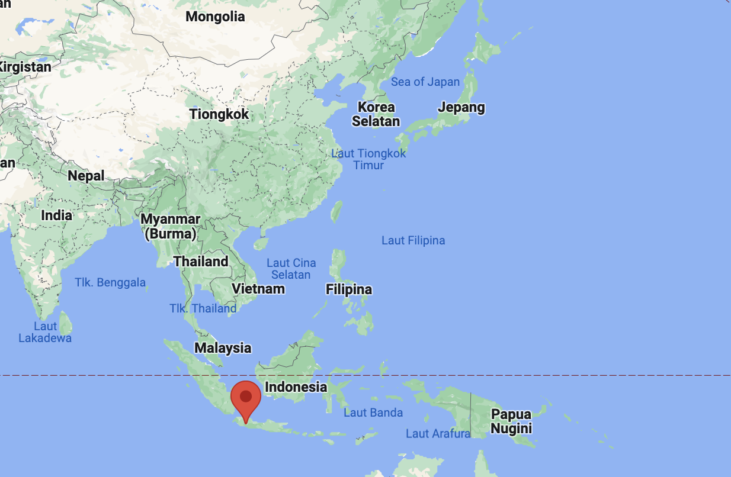
Location

Slide 4

Institut Teknologi Bandung (ITB)
🌍 Global Rankings
QS World Rankings 2025: #256
QS Asian Rankings 2025: #59
THE World Rankings 2025: 1201–1500
THE Asia Rankings 2024: 401–500
💡 Innovation
Startups: 244
Intellectual Property Rights (IPR): 1,176
Innovations: 212
Tenants: 972
🎓 Education and Teaching
Multicampus: 4
Faculties and Schools: 12
Study Programs: 137
Joint Degrees: 10
Lecturers: 1,422
Students: 27,506
🔬 Research
Research Centers: 26
Centers of Excellence in Science and Technology: 9
Research Institutes: 7
Expertise Groups: 113
Laboratories: 198
Scopus-indexed Journals: 1,248
International Journals: 421
International Proceedings: 674

Slide 5

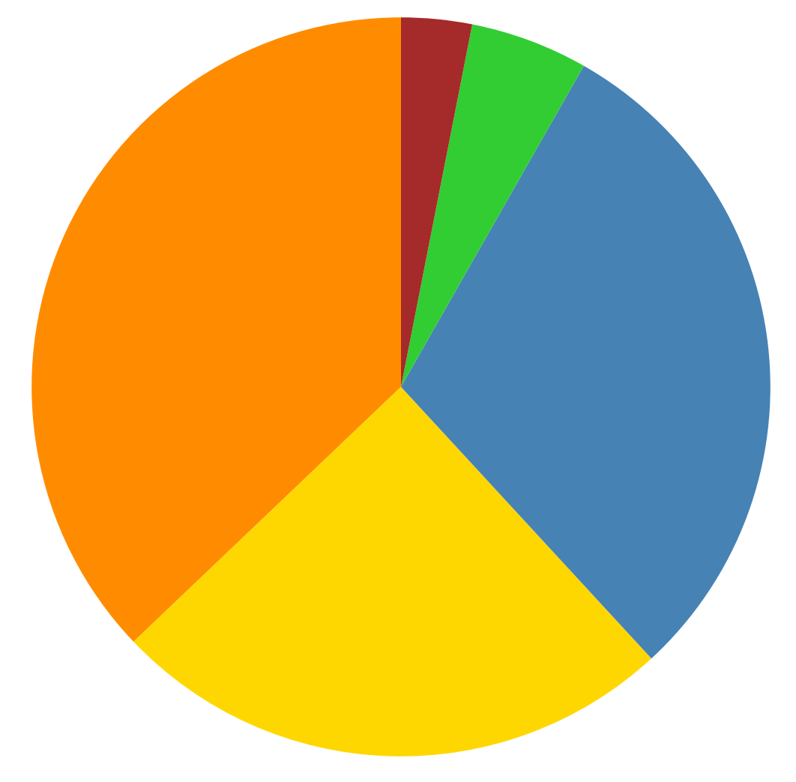
Lecturer : graduated from the country (N=109)
Australia
3%
US
5%
Lecturer : 105
Researcher : 4
Japan, Korea &
other Asian
37 %
Indonesia
30 %
Europe
25 %

Slide 6

Undergraduate Programs
Geological Engineering
Geodesy and Geomatics Engineering
Meteorology
Oceanography
Graduate Programs
Geological Engineering (master and doctoral programs)
Geodesy and Geomatics Engineering (master and doctoral programs) – Disaster Risk
Earth Sciences (master and doctoral programs) – Climate Change
Groundwater Engineering (master program)

Slide 7
FITB student population

Slide 8
Research Groups
Paleontology and Quaternary Geology
Geodynamic and Sedimentology
Petrology, Volcanology, and Geochemistry
Applied Geology
Engineering Science and Geodetic Innovation
Spatial and Cadaster Systems
Geographic Information Science and Technology
Hydrography
Atmospheric Sciences
Environmental and Applied Oceanography

Slide 9





More information:
Jalan Ganesa No. 10, Bandung 40132
Phone. (+6222) 2514990, Fax. (+6222) 2514837
E-mail: sisfo@fitb.itb.ac.id
Web: fitb.itb.ac.id
@fitb_itb
@ITB_FITB
FITB ITB
official.fitb.itb

Slide 10

End

